Slide 1

Intelligence Writing
& Briefing

Slide 2


Focuses on the past
Does not inform decisions
Detailed for Burden of proof
Generalized Conclusions at end of paper
Summaries of others work
Focuses on the future
Explores real problems
Only information required for decision
Written for busy decision makers with Conclusion up front.
Explores implications of problems

Slide 3
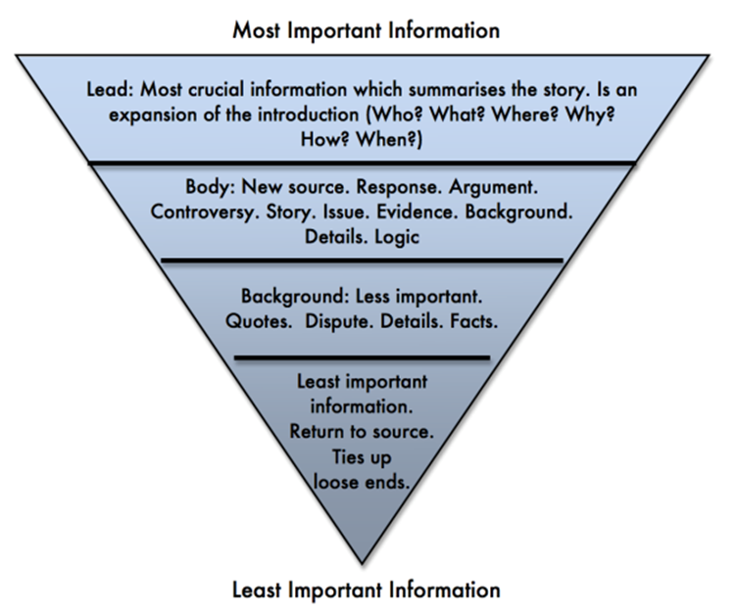
BLUF = Bottom Line Up Front
The key is to put the most important information first
Don’t save the good stuff for later – your reader may never get there
Paragraphs are judgments
Sub-bullets are evidence

Slide 4

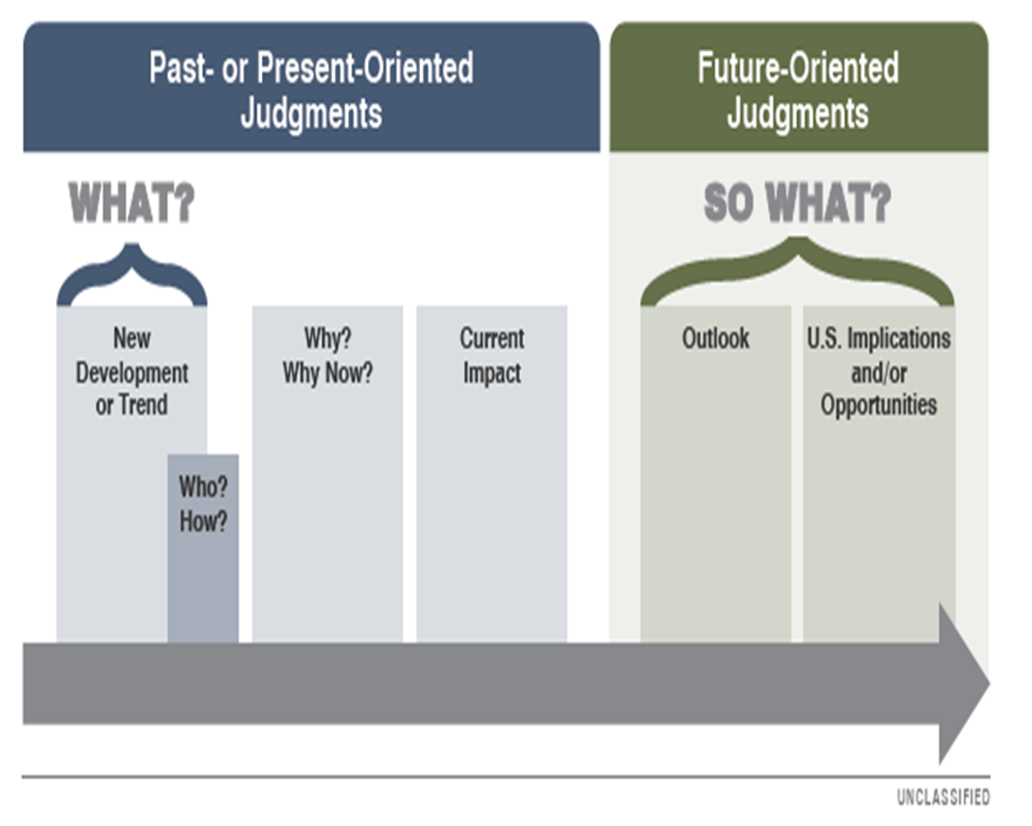
BLUF Should Be Your Main Judgment!
Structure:
Judgment (What/So What)
Evidence (What)
Implications & opportunities (So What)
Likelihood
Likelihood
Likelihood

Slide 5

Who are you briefing?
What are their interests
What role do they play in decision-making
What is their schedule or agenda?
Are they an expert in what you are presenting?
Has someone written on your topic before?
RELEVANCE
At a minimum you must include importance and implications to NATO and/or your country.

Slide 6

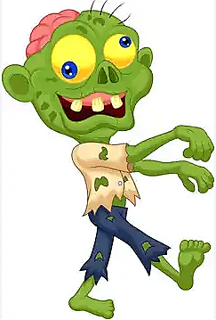
Clear and Concise Language
GOAL: Present your reader with a clear understandable analytic message.
Clear distinction between Judgment, evidence, and assumption
Written for intermediate reading skills
Short sentences
No Jargon or technical terms
Reduce adjective and adverbs
Active V. Passive Voice
Active Voice | Students learned tradecraft.
Passive Voice | Tradecraft was learned…
“…by zombies”

Slide 7
HUMINT Summaries
Football Example
The Exception to the BLUF Rule
Summary of sources
Short analytic comment.
Based on reliable scouting reports, Germany is likely to play in a 4-3-3 formation with their attack focused on scoring from close range. The team also practiced defending against counters. It is likely that number 7 their key midfielder is injured. He was seen taking light exercise with the presence of a physiotherapist. Number 14 was seen practicing with the other starters instead.
Analyst Comment: Disrupting Germany's midfield and exploiting potential defensive weaknesses on the counter is probably the most effective approach against Germany’s expected style of play in the finals. The status of number 7 and the role of number 14 are key variables to watch as it may affect the team’s midfield formation.

Slide 8
Intelligence Summaries
Football Example
Germany will likely continue to utilize a 4-3-3 formation in the final match to challenge England in the midfield. We have high confidence in this assessment because multiple sources independently observed and reported corroborating information about the team’s consistent use of the formation in the past for both training and live matches.
​Germany played their semi-final match in a 4-3-3 formation, according to a review of archived UEFA semi-final footage.
​The starting players in the final training session were the same as those from the semi-final, according to a scouting report from a reliable source who observed Germany’s final training session.
​The team's formation during the final training session was also a 4-3-3, according to a ground’s keeper who observed Germany’s final training session.
BLUF: Main Judgment including what/so what and uncertainty terms. Confidence statement to include why you chose the level of confidence.
Evidence from Source
Evidence from Source
Evidence from Source
Vulnerability or opportunity
Each Topic:
  1 Page
  3 bullets

Slide 9
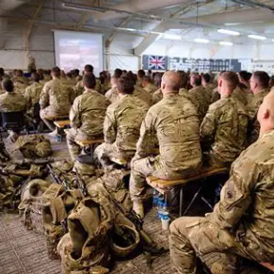
Briefing
Same principles as writing:
  BLUF = Judgment
  Clear and Concise Message
  Tailor to your audience
  Add a graphic
Notes:
File:Soldiers in Briefing at RSOI in Camp Bastion, Afghanistan MOD 45154541.jpg - Wikimedia Commons

Slide 10

What Type of Brief Will We Be Doing?
Elevator Brief:
Short – 5 to 7 minutes total
Time it takes for you and your senior officer to ride an elevator.
Main judgment and important evidence only.
Be prepared for questions
Decision Brief:
The audience for your brief will use the information you provide to make a decision.
Understand what responsibilities your audience has in the decision space and tailor your brief accordingly.
If time, include adversarial vulnerabilities that may lead to opportunity for action.
Use an AI tool to simulate questions from a senior military audience

Slide 11
Briefing Tips
Make eye contact
Watch your hands
Formal, but not too formal
Do not read slides or scripts
Know your audience and tailor to them (Read the Room)
Walk or deep breathing for nerves
Stick to your analytic message
Be prepared for questions
Be prepared to take questions away with you

Slide 12
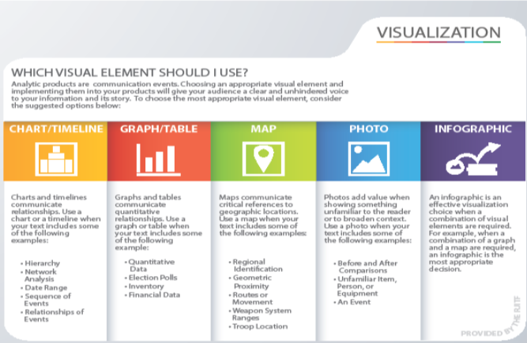
In our assignment you will:
Use an indicators visual
Include the main judgment for your KIQ
Vulnerabilities/opportunities
Intelligence Gaps

Slide 13

Title
Main Judgment Here
Evidence Here:
Category | 12 months | 9 months | 6 months | 3 months
P
E
M
S
I
I
Observed
Critical Concerning Anomaly Normal

