Slide 1

Signposts & Indicators
Spotting early signs of significant change

Slide 2




What are Signposts and Indicators?
Indicators – Observable pieces of information or events (The What)
Signposts – A collection of indicators that when viewed together suggest a specific trend, pattern or direction. (The So What or What’s Next)
Indicator
Signpost
Notes:
The human mind sometimes sees what it expects to see and can overlook the
unexpected. Identification of indicators creates an awareness that prepares the mind
to recognize early signs of significant change. Change often happens so gradually
that analysts do not see it, or they rationalize it as not being of fundamental
importance until it is too obvious to ignore. Once analysts take a position on an
issue, they can be reluctant to change their minds in response to new evidence.

Slide 3
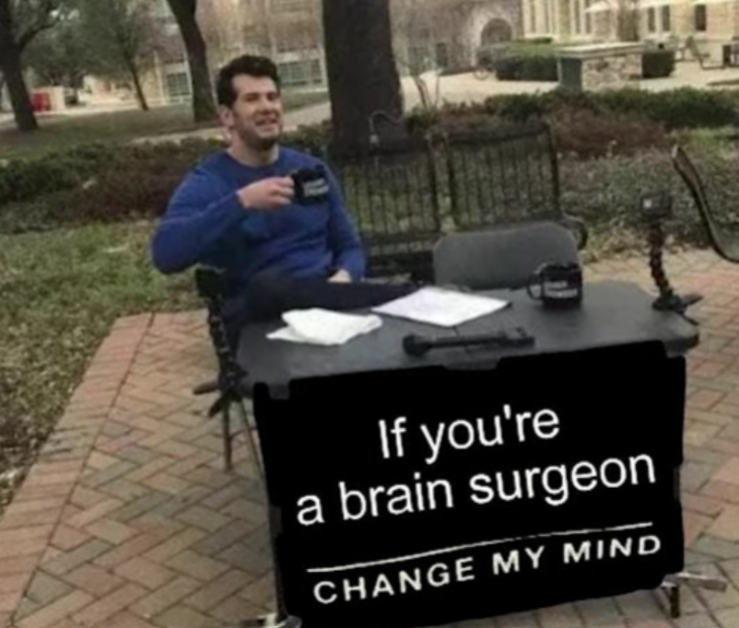
Why Do Use Signposts and Indicators?
Signposts and Indicators provide an objective baseline for tracking events and help achieve the following:
  Detect and monitor changes over time.
  Evaluate competing hypotheses or scenarios.
  Identify and drive collection opportunities.
  Consider various paths a situation could follow.
  Substantiate emerging viewpoints
  Overcomes expertise bias.
  Helps decision makers track future developments Builds a more concrete case for the analytic conclusions
Notes:
The human mind sometimes sees what it expects to see and can overlook the
unexpected. Identification of indicators creates an awareness that prepares the mind
to recognize early signs of significant change. Change often happens so gradually
that analysts do not see it, or they rationalize it as not being of fundamental
importance until it is too obvious to ignore. Once analysts take a position on an
issue, they can be reluctant to change their minds in response to new evidence.

Slide 4
Focus on Indicators
Indicators should be:
Observable and collectible: There must be some reasonable expectation that, if present, the indicator will be observed and reported by a reliable source.
Valid: An indicator must be clearly relevant to your intelligence question and judgment.
Reliable: Those observing and collecting data must observe the same things consistently over time.
Stable: An indicator must be useful over time to allow comparisons and to track events
Unique: An indicator should measure only one thing . Indicators should not only be consistent with a specified scenario or hypothesis but also inconsistent with alternative scenarios or hypotheses.

Slide 5



Focus on Indicators (Cont)
Unique: An indicator should measure only one thing . Indicators should not only be consistent with a specified scenario or hypothesis but also inconsistent with alternative scenarios or hypotheses.
What does this sound like?
High Diagnostic Value – evidence provides clear support to only one conclusion or assessment
Low Diagnostic Value – evidence is so general that it could describe or support any number of conclusions
Diagnosticity

Slide 6

Thought Models
Sustainment
Training
Environment
Employment
Personnel
Roles and Missions
Intangibles
Structure
Equipment
Political​
Military​
Economic​
Social​
Infrastructure
Information
Diplomatic
Information
Military
Economic

Slide 7
How Do We Communicate Indicators
Timeframe
Diagnosticity/Concern
Observable
12 Months |  | 9 Months |  | 6 Months |  | 3 Months
 | Indicator |  | Indicator |  | Indicator |  | Indicator
 | Indicator |  | Indicator |  | Indicator |  | Indicator
 | Indicator |  | Indicator |  | Indicator |  | Indicator
Very diagnostic
Easy to collect
Actively Observed
Diagnostic
Sometimes Collected
Partially Observed
Not Diagnostic
Hard to collect
Intangible

Slide 8

Football Example
Germany sticks to 4-3-3 Play
Germany abandons 4-3-3 Play
Very diagnostic
Diagnostic
Not Diagnostic
90 min |  | 75 Min |  | 45 Min |  | 30 Min |  | 15 Min
 |  |  | The two wingers and the central striker consistently stay in their assigned forward positions |  |  |  | The German full-backs are frequently running forward to get past their wingers.
 | The three central midfielders stop playing in their staggered positions and instead form a horizontal line with the attacking wide players who have dropped back. |  |  |  | the German wingers start tracking back to defend, essentially becoming extra full-backs

