Slide 1

Using SWOT to Analyze National Security Issues

Slide 2

What is SWOT
Strategic Planning Business Technique created in the 1970s for an organization’s self assessment.
  Company’s competitive position and guide strategic decisions
Adapted to National Security to help with critical thinking.
  Nation’s ability to protect itself, deter adversaries and maintain stability. Informs defense strategy, diplomacy and decision making.
  In terms of threat, technique allows assessment of both the attacker or defender

Slide 3
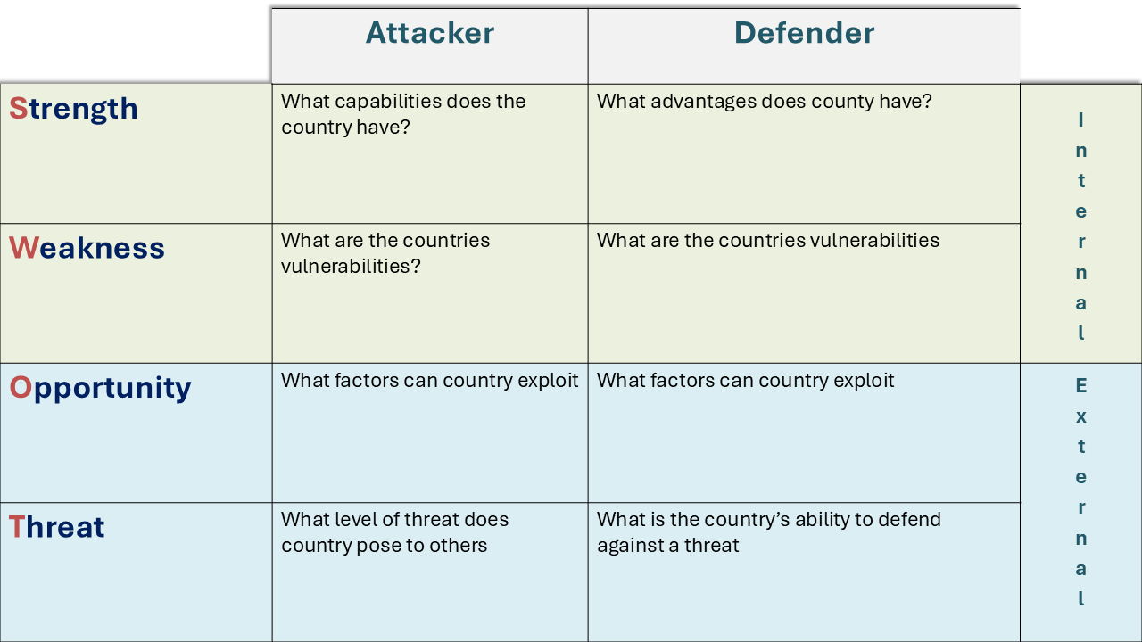
SWOT Analysis for Warning

Slide 4
SWOT Analysis for Warning
Internal: Factors an actor can control and change
External: Factors present in the environment that effect an actor.
How does this help us with Warning?

Slide 5
 | Attacker | Defender
Strength | What capabilities does the country have? | What advantages does county have? | Internal
Weakness | What are the countries vulnerabilities? | What are the countries vulnerabilities
Opportunity | What factors can country exploit | What factors can country exploit | External
Threat | What level of threat does country pose to others | What is the country’s ability to defend against a threat

Slide 6
Internal
Strengths
Weakness
Opportunity
Threats
External

Slide 7

Germany V. England
Internal
You are the German Coaching Staff preparing for the EURO Final against England.
Strengths
Weakness
Opportunity
Threats
External

Slide 8

Let’s Practice!
Group Work
Our exercise scenario
Data in scenario book
Create a SWOT matrix for both attacker and Defender
Attacker Matrix (30 minutes)
Defender Matrix (30 minutes)
Group presents most confident quadrant
          (5 Minutes)
Refine (15 Minutes)
Final Group Presentation for most significant insights (5-7 Minutes)

Slide 9

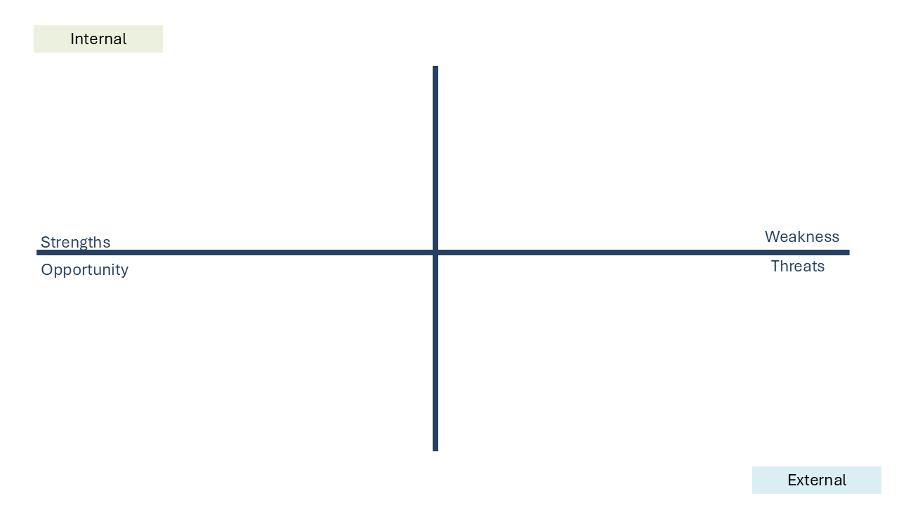
  Remember your KIQ
  Remember you are writing a warning product and briefing it to the J2
  Did we learn a technique that would be useful in completing your assignment?
  Remember to note source quality

Slide 10

Tradecraft is Awesome!
Group
Presentations

