Slide 1


Thought Models
Adding Rigor to Your Thinking
Notes:
Most of this brief was taken from: The NATO Alternative Analysis Handbook December 2017 ISBN (PDF Version) 978-92-845-0208-0
Unless otherwise noted. (U)

Slide 2
Thinking Models
Domain Frameworks
Outside In Thinking
Taxonomies
Helps identifies a full range of factors that may directly or indirectly shape a situation.
Often provides aa wider conceptual and contextual framework, uncovering additional factors, important dynamics, or relevant alternative hypotheses.
Notes:
The NATO Alternative Analysis Handbook December 2017 ISBN (PDF Version) 978-92-845-0208-0

Slide 3

SMART PITCH
Squad Quality
Management
Attitude (Psychological Factors)
Resources and Infrastructure
Tactics and Style of Play
Physical and Medical
Intangibles
Timing and Context
Crowd and Culture
Hidden Factors
Football Example
Notes:
ChatGPT results from question create me a mneumonic taxonomy to assess the capabilities of a premiere league soccer team (U)

Slide 4
PMESII
Political​ - Refers to the political landscape, including government structure, policies, and international relations.
Military​ - military capabilities, including troop levels, equipment, and strategic planning.
Economic​ - economic policies, trade relations, and financial stability.
Social​ - social dynamics, including population, culture, and human rights.
Infrastructure - physical infrastructure, including transportation, utilities, and communication systems.
Information -Communication systems, media influence, and the flow of information.
Notes:
The NATO Alternative Analysis Handbook December 2017 ISBN (PDF Version) 978-92-845-0208-0

Slide 5
DIME
Diplomatic –relations between states or international organizations.
Information -Communication systems, media influence, and the flow of information.
Military​ - military capabilities, including troop levels, equipment, and strategic planning.
Economic – Use of economic tools

Slide 6

STEEPRISE
Sustainment - Defense budgets, Military infrastructure, Defense industries, Logistics
Training - Individual/unit, Complexity and realism
Environment - Physical geography, Human/cultural geography
Employment – Strategy, Doctrine, Tactics
Personnel – Demographics, Active duty/reserves
Roles and Missions - Warfighter (e.g., invade, seize, compel), Defender (e.g., deter, defend border), Peacekeeper (e.g., enforce international mandate, provide international disaster relief), Firefighter (e.g., maintain infrastructure, offer domestic disaster relief), Police officer (e.g., offer regime protection, perform counternarcotics efforts, execute counterterrorism functions).
Intangibles, Leadership, Military culture, Innovation and adaptability
Structure – Organization, Command and control (C2)
Equipment – Firepower, Mobility, Survivability

Slide 7
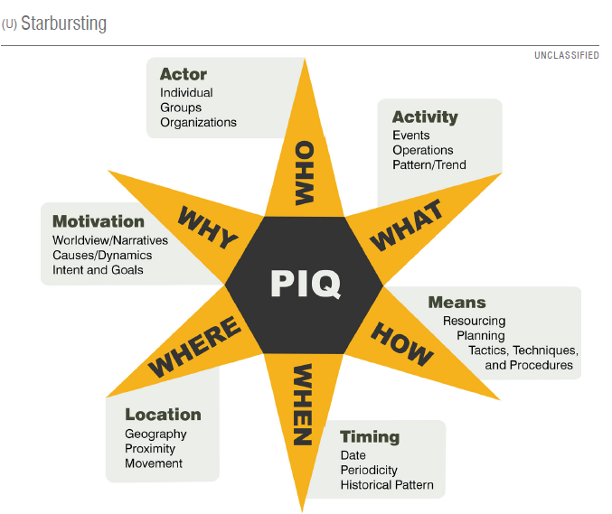
Starburst
Structured brainstorming technique that helps us:
Examine aspects of an issue more fully
Consider a broader range of ideas and perspectives
Anticipate and preempt customers’ questions

Slide 8
When to Use Thought Models?
Often Used to Add Structure to Brainstorming
Create multiple hypotheses
SWOT Analysis
Indicators and Signposts
Implications

Slide 9


