Slide 1
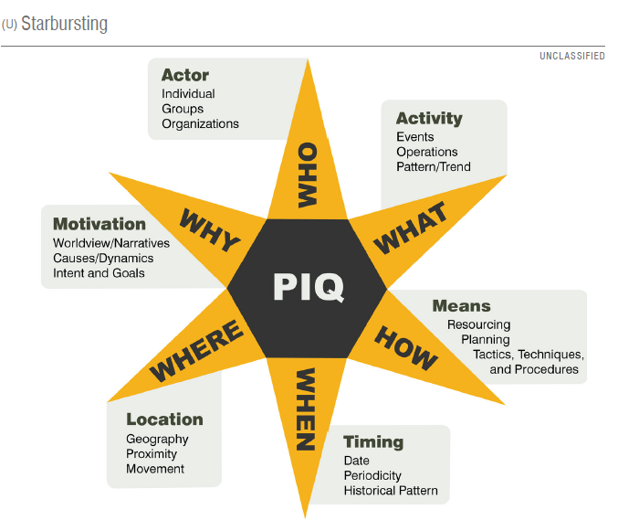
Develop Multiple Hypotheses to Answer a Question
Generate multiple hypotheses to answer a question.
Strongest hypothesis is your main judgment. This is the one that has the most supporting evidence,
The second most supported hypothesis is your alternative.
Use the What/So What Construct
Use probability language.
Notes:
Graphic from: NGIC Structure Analytic Techniques Handbook. Book is CUI, graphic is U.
Source: NGIC Analytic training: https://inteldocs.intelink.gov/files/details/DEB415D9-1A3C-480F-94C6-B7E7272D256C
ODNI https://inteldocs.intelink.gov/files/details/39AF0005-722A-4715-9AC4-4BBE2BE973D3

Slide 2
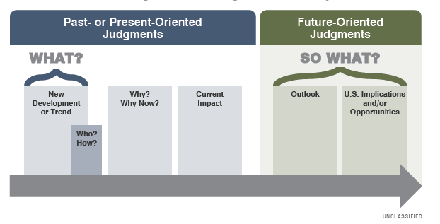
How to Write a Hypothesis
The What (Change) What is the new or emerging issue, development, or opportunity evident in the reporting?
The Who (Actors) Who are the principle foreign actors What are their goals and/or broader concerns
The Why (Factors and Drivers) Would the customer benefit from addressing the “why of the what” instead of focusing directly on the what? Why is the change occurring? What factors/drivers are most important with regard to the change?
So What (The Outlook) What is most likely to happen next regarding the change? How will the What evolve over the next set timeframe?
So What (Implications) What are the implications for the United States regarding the change moving forward?
Likelihood
Germany will almost certainly dominate play when their midfielders push forward. This high-pressing possession-based system will challenge England’s current midfield defense posture.
Germany will almost certainly dominate play when their midfielders push forward. This high-pressing possession-based system will challenge England’s current midfield defense posture.
Likelihood
Likelihood
Notes:
Source: NGIC Analytic training: https://inteldocs.intelink.gov/files/details/DEB415D9-1A3C-480F-94C6-B7E7272D256C
ODNI https://inteldocs.intelink.gov/files/details/39AF0005-722A-4715-9AC4-4BBE2BE973D3

Slide 3


Slide 4
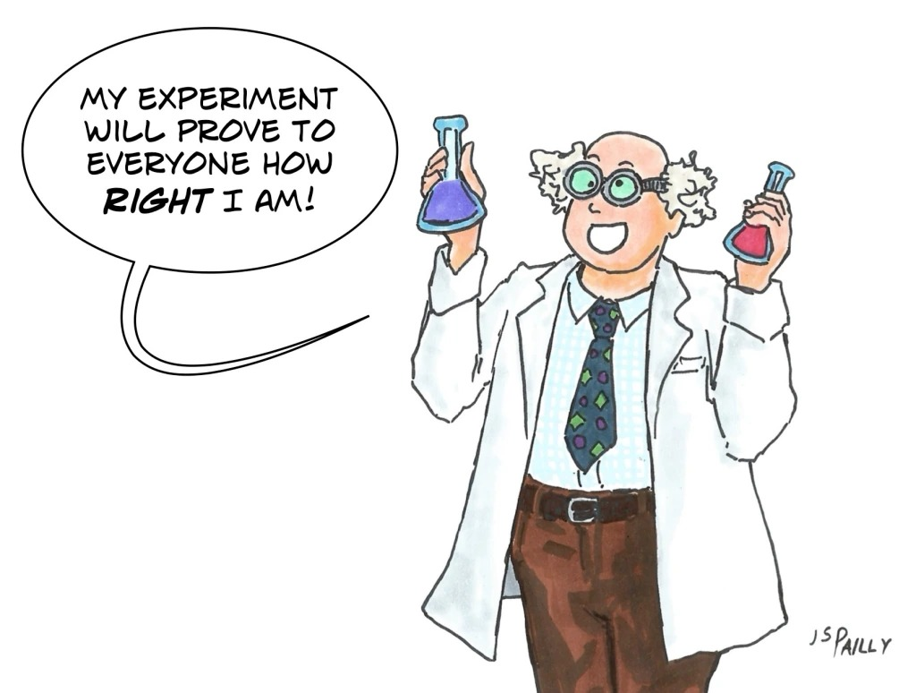
Hypothesis Testing
Showing your Work

Slide 5

Why Do We Create Multiple Hypotheses?
Why Do We Test Hypotheses?
Test Hypotheses:
Illustrates the relationship between hypothesis, evidence and assumptions
Rigorous technique to determine the main judgment or assessment
Helps determine Uncertainty
Technique allows analysts to show their work.
Multiple Hypotheses:
  Reduces Confirmation Bias
  Explores the Problem Space
  Structures Thinking
  Facilitates Consideration of Alternatives
Go back to hypotheses and note mutual exclusive

Slide 6

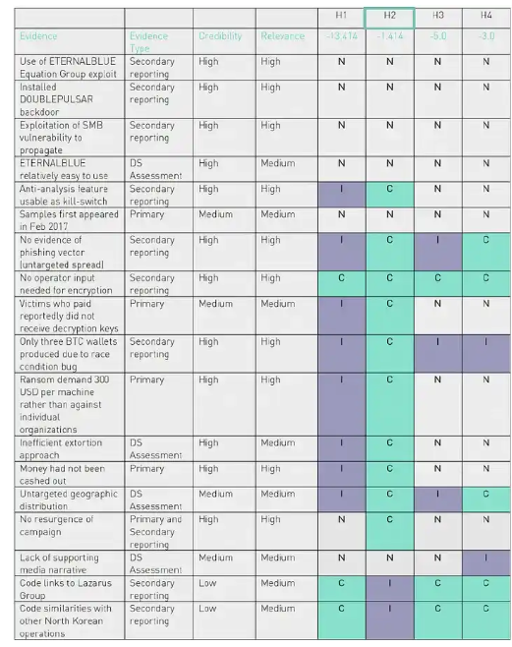
Alternative Competing Hypotheses (ACH) --Simplified
Test multiple hypotheses simultaneously by requiring that all reasonable alternatives be explicitly identified and assessed.
Works to reduce confirmation bias by getting analysts to rule out hypotheses based on available evidence and assumptions instead of creating a favorite hypothesis and trying to find evidence that may support it.
Challenges analysts to think about the diagnosticity of the evidence.
ACH as conceived by Heuer is a complex mathematical technique that takes a long time to complete. We will simplify it for our purposes. The book is still worth a read!
Notes:
ACH matrix by Rafael Amado, for Digital Shadows, aimed at threat actor attribution for the WannaCry ransomware. Amado’s article is an excellent example of ACH implementation in CTI.
https://anticitizenone.medium.com/analysis-of-competing-hypotheses-176bd8147dbc

Slide 7




Diagnosticity
Easy Concept to understand, but often neglected in analysis.
The discriminatory power of a piece of information. How well does a piece of evidence discriminate between competing explanations or possibilities.
It helps to judge the relative likelihood of multiple hypotheses.
Football Example: England V. Germany
H1: England wins the match
H2: Germany wins the match
High Diagnostic Evidence: England scores the first goal early in the match.
Why: scoring early increases the probability of a team winning the match. Germany would have to overcome a disadvantage.
High Diagnostic Value – evidence provides clear support to only one conclusion or assessment
Low Diagnostic Value – evidence is so general that it could describe or support any number of conclusions
Low Diagnostic Evidence: England has possession of the ball for 55% of the match
Why: 55% possession in a match is not statistically significant enough to give one team an advantage.
Notes:
https://www.vecteezy.com/vector-art/4560340-abstract-diagnostic-pulse-icon-illustration

Slide 8

Sensitivity
Are any of your hypotheses sensitive to change?
What could affect or change your hypothesis?
  Source quality
  Intelligence Gaps
  Assumptions
  Wild Cards

Slide 9

How to complete an ACH Exercise
8 Steps
Create Multiple Hypotheses
Find evidence (sources) and review quality
Fill In matrix with hypotheses and evidence
Decide on diagnosticity of evidence in relation to hypothesis
Explore tentative insights and conclusions
Review sensitivity
Select your main judgment and most plausible alternative.
Be ready to defend.
Notes:
Image: https://www.vecteezy.com/vector-art/40282422-stair-to-success-career-path-or-step-to-achieve-business-target-ladder-of-success-improvement-or-challenge-to-reach-goal-growth-or-ambition-concept-businessman-running-up-stair-to-reach-goal

Slide 10
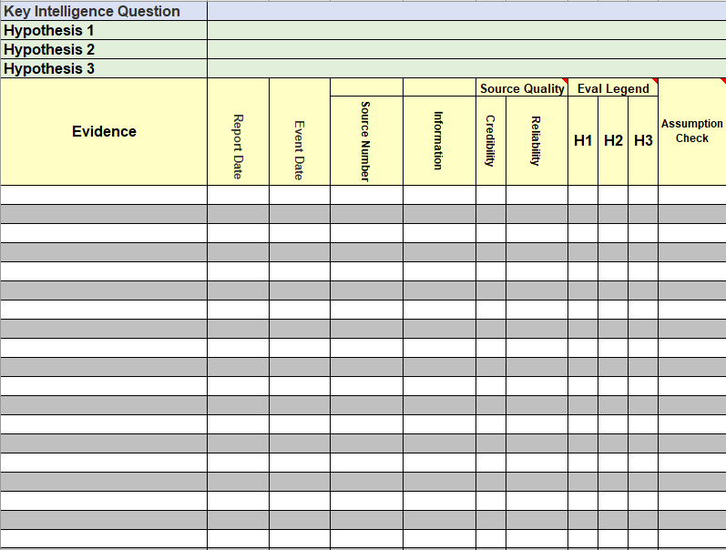
Simplified ACH Matrix
Plus (+) supports a hypothesis
Minus (-) refutes a hypothesis
Zero (0) neither supports or refutes
Two pluses (++) strongly favoring hypothesis
Two minuses (–) strongly against hypothesis

Slide 11

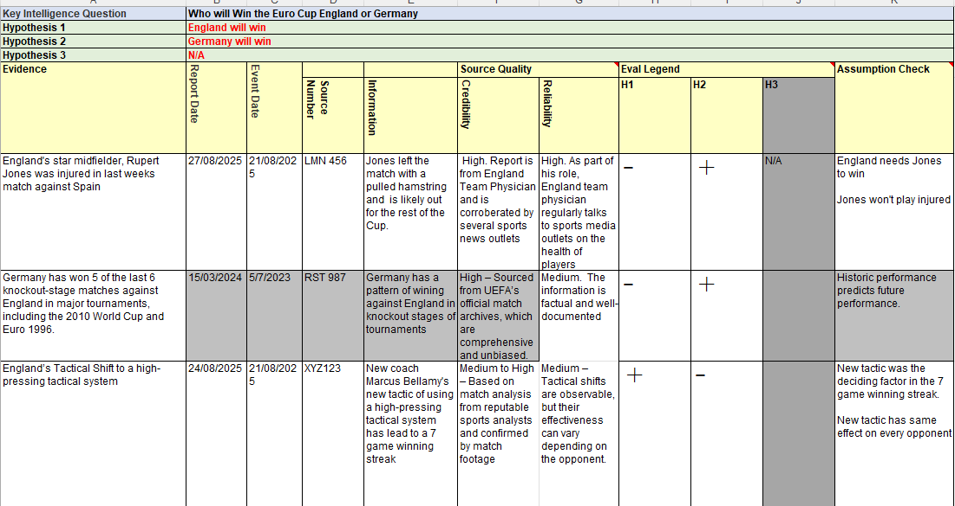
Football Example

Slide 12


