Slide 1

Tradecraft Intro

Slide 2
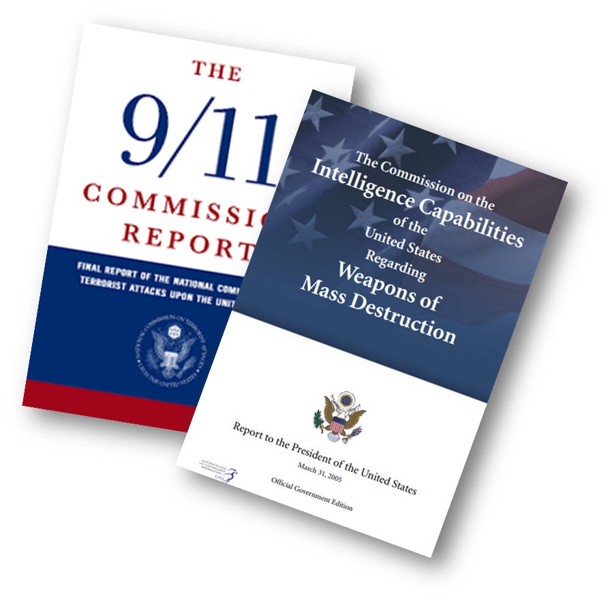
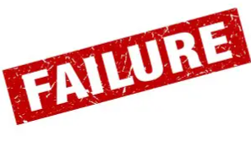
Why Do We Use Analytic Tradecraft?
9/11:
  Lack of Imagination
  Bias
  No Information Sharing
  New Transnational Threats
Intelligence
WMD & Iraq:
  Untested Assumptions and Inferences
  Intelligence Gaps/Lack of evidence
  No Source Vetting or Clear Descriptions
  Uncertainties/probabilities
Notes:
As most of you are aware, the US suffered two very public intelligence failures in short succession in the early 2000s, 9/11 and WMD in Iraq.
Prior to this point in history, US intelligence agencies largely trained intelligence analysts through mentoring and some technical training as necessary. Junior analysts learned intelligence analysis best practices from senior analysts and through trial and error in their own experiences. Agencies also rarely collaborated on assessments or shared information.
In the aftermath of each intelligence failure, the US Congress investigated the causes of each failure. They found a failure of imagination, significant bias, a lack of evidence, untested assumptions and a lack of clarity in probability of an assessment.
The US IC also failed to share info, failed to coordinate assessments and allowed their assessments to become politicized.
https://en.wikipedia.org/wiki/9/11_Commission_Report
https://en.wikipedia.org/wiki/Iraq_Intelligence_Commission

Slide 3


U.S. Analytic Standards & Tradecraft Standards
2 Types of Standards
Analytic Standards | Overarching principles meant to reenforce analytic integrity.
Tradecraft Standards | Common Foundational tools to guarantee rigor in analysis
Notes:
So what do these standards look like?
There are five analytic standards that address the integrity of an assessment. They are overarching principles that reflect the lessons learned from the 9/11 and WMD commission investigations.
Tradecraft standards are the common foundational assessment criteria analysts use on a daily basis to ensure analytic rigor and quality.
Let’s dive a
https://www.dni.gov/index.php/what-we-do/ic-related-menus/ic-related-links/intelligence-community-directives
bit deeper into each.

Slide 4
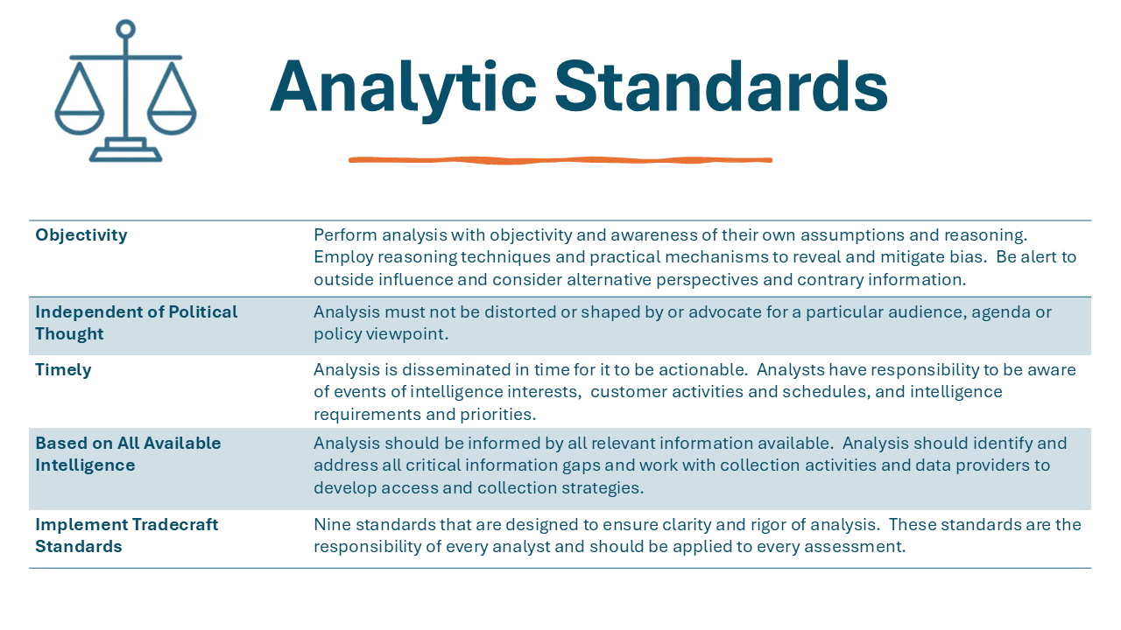
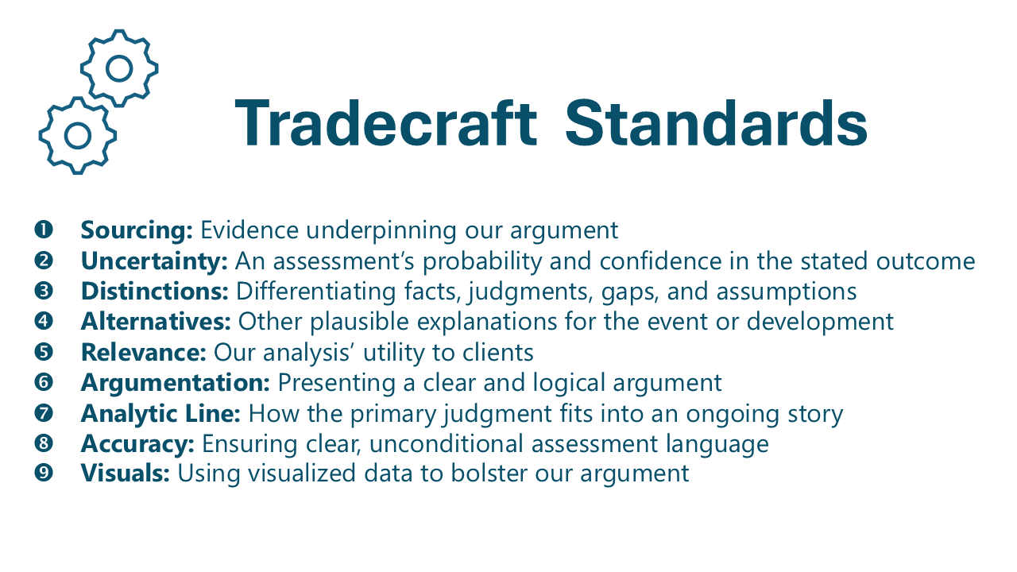
U.S. Analytic & Tradecraft Standards
Overarching principles meant to reenforce analytic integrity.
Common Foundational tools to guarantee rigor in analysis

Slide 5
Analytic Standards
Objectivity | Perform analysis with objectivity and awareness of their own assumptions and reasoning. Employ reasoning techniques and practical mechanisms to reveal and mitigate bias. Be alert to outside influence and consider alternative perspectives and contrary information.
Independent of Political Thought | Analysis must not be distorted or shaped by or advocate for a particular audience, agenda or policy viewpoint.
Timely | Analysis is disseminated in time for it to be actionable. Analysts have responsibility to be aware of events of intelligence interests, customer activities and schedules, and intelligence requirements and priorities.
Based on All Available Intelligence | Analysis should be informed by all relevant information available. Analysis should identify and address all critical information gaps and work with collection activities and data providers to develop access and collection strategies.
Implement Tradecraft Standards | Nine standards that are designed to ensure clarity and rigor of analysis. These standards are the responsibility of every analyst and should be applied to every assessment.
Notes:
Here are the five analytic standards:
Objectivity: We need to recognize our individual and institutional biases and work to mitigate them.
Political thought: We must follow the intelligence evidence and not be influence by the political environment or specific policy preferences of decision makers, politicians or political parties. We must speak truth to power.
Timely: Intelligence assessments should be disseminated in time to be actionable. We need to be aware of events of intelligence interest, customer activities and schedules, and intelligence requirements and priorities.
All Available Intelligence: We must consider all available intelligence. This means an analyst must complete due diligence to guarantee all available information was reviewed. It also means that contradictory evidence can not be discounted. Analysts are also responsible for identifying intelligence gaps for appropriate intelligence collectors and being transparent about when those gaps impact our assessments.
Implement Tradecraft Standards: Following nine standards are designed to ensure rigor and clarity in our analysis. Let’s explore these.
https://www.dni.gov/index.php/what-we-do/ic-related-menus/ic-related-links/intelligence-community-directives

Slide 6
Tradecraft Standards
❶ Sourcing: Evidence underpinning our argument
❷ Uncertainty: An assessment’s probability and confidence in the stated outcome
❸ Distinctions: Differentiating facts, judgments, gaps, and assumptions
❹ Alternatives: Other plausible explanations for the event or development
❺ Relevance: Our analysis’ utility to clients
❻ Argumentation: Presenting a clear and logical argument
❼ Analytic Line: How the primary judgment fits into an ongoing story
❽ Accuracy: Ensuring clear, unconditional assessment language
❾ Visuals: Using visualized data to bolster our argument
Notes:
In contrast to the analytic standards that provide overarching guidance on how to approach analysis, the tradecraft standards are used on a daily basis by analysts to improve the rigor and quality of their analysis.
They address specific aspects of an assessment and describe how to optimize each aspect to improve the clarity and effectiveness of an analyst’s intelligence judgements.
We have nine of these tradecraft standards.
Go through the standards…
https://www.dni.gov/index.php/what-we-do/ic-related-menus/ic-related-links/intelligence-community-directives

Slide 7


Slide 8
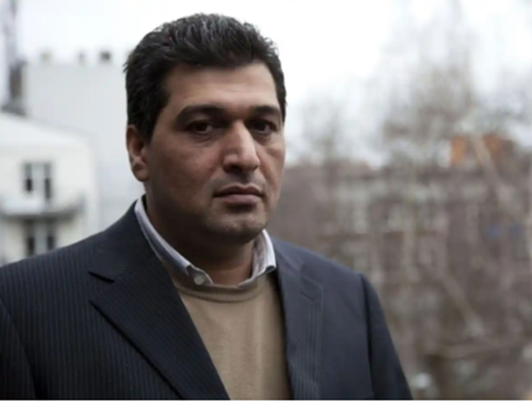
Sourcing: The Fundamental Tradecraft Standard
  Iraq WMD Intelligence Failure
  Sources are the evidence that leads to hypothesis creation.
  Source quality underpins your assessment.
  It is critical to understand and convey the quality and credibility of your sources.
Rafid Ahmed Alwan al-Janabi
Curveball
A source can be a person, document, passage, quotation, data record, database, tweet, email, book, web page, etc.
Notes:
Anyone know who this is? Curveball. He was the source on which the entirety of the analysis that Iraq was actively manufacturing WMDs was based on. US Secretary of State Colin Powell publicly presented Curveball’s information at the UN.
It was later found that Curveball, a chemical engineer, lied and made up all of the information he supplied to intelligence agencies thinking he could obtain a German Visa by being useful to the government.
This example illustrates how critical sources are to the quality of your analysis. They are the building blocks of your argument and If you have weak sources your argument will collapse.
NIFC Tradecraft Handbook 2024
https://en.wikipedia.org/wiki/Curveball_(informant)
Curveball picture: https://www.google.com/imgres?q=curveball%20iraq&imgurl=https%3A%2F%2Fstatic.independent.co.uk%2Fs3fs-public%2Fthumbnails%2Fimage%2F2012%2F03%2F31%2F20%2F32-WMD1-BBC.jpg%3Fwidth%3D1200&imgrefurl=https%3A%2F%2Fwww.independent.co.uk%2Fnews%2Fworld%2Fpolitics%2Fman-whose-wmd-lies-led-to-100-000-deaths-confesses-all-7606236.html&docid=JoFgpbf8U9GjCM&tbnid=JepsLlTKkWSNaM&vet=12ahUKEwijk9Wb4M6IAxVN8rsIHQXLHcUQM3oECG8QAA..i&w=1200&h=900&hcb=2&ved=2ahUKEwijk9Wb4M6IAxVN8rsIHQXLHcUQM3oECG8QAA
Powell picture: https://www.google.com/url?sa=i&url=https%3A%2F%2Fwww.aljazeera.com%2Fnews%2F2021%2F10%2F18%2Fstain-on-powells-record-lies-to-the-un-about-iraqs-weapons&psig=AOvVaw3lsysB46lWQczvNqlrpIiQ&ust=1726825906007000&source=images&cd=vfe&opi=89978449&ved=0CBQQjRxqFwoTCKC44YjezogDFQAAAAAdAAAAABAE

Slide 9
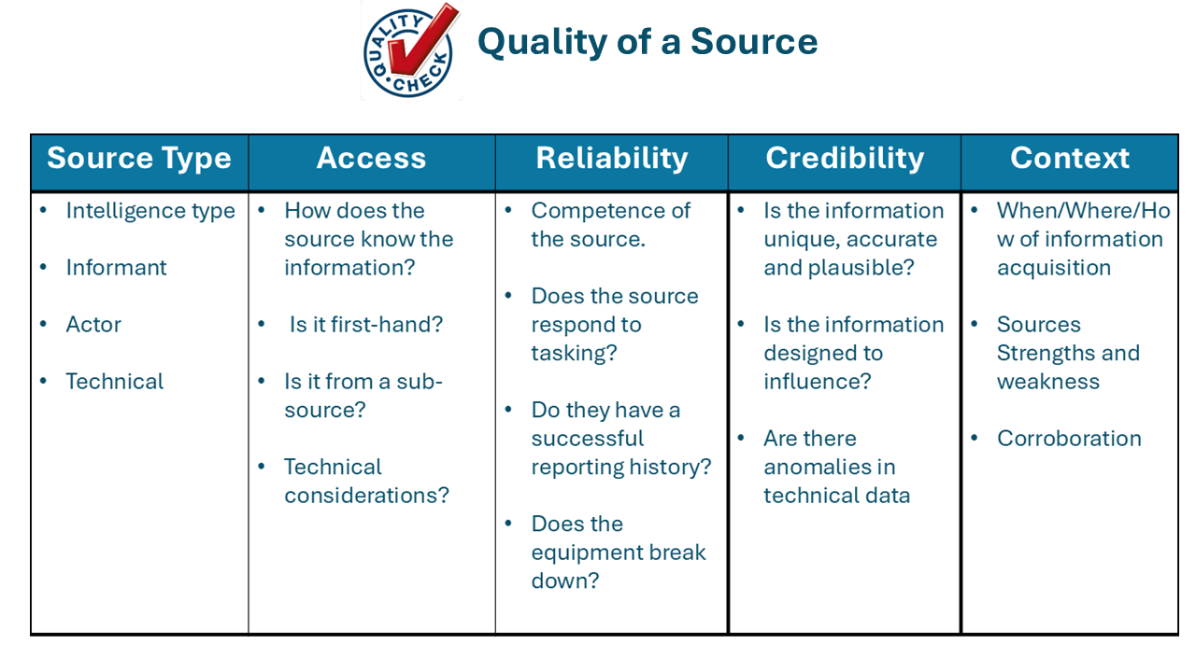
Assessing Sources
We Assess Both:
Individual Sources: What is the quality and credibility of the source as it relates to the judgment it supports?
Body of Evidence: Do all of your sources taken together effectively tell a story that answers your intelligence question?
Notes:
Image: https://www.flaticon.com/free-icon/investigation_4620300?related_id=4620327&origin=search
https://inteldocs.intelink.gov/files/details/7389C13F-6869-4B31-B309-C46CDF259309
https://inteldocs.intelink.gov/files/details/7A1127CF-6EFA-426F-8AA8-91375CEFEE8B
Inteldocs | IC Analytic Tradecraft Standard 1 DIA Tradecraft Note 2-17 Sourcing.pdf (intelink.gov)
https://www.dni.gov/index.php/what-we-do/ic-related-menus/ic-related-links/intelligence-community-directives
https://www.dni.gov/index.php/what-we-do/ic-related-menus/ic-related-links/intelligence-community-directives
Inteldocs | IC Analytic Tradecraft Standard 1 DIA Tradecraft Note 2-17 Sourcing.pdf (intelink.gov)
NIFC Tradecraft Handbook 2024

Slide 10

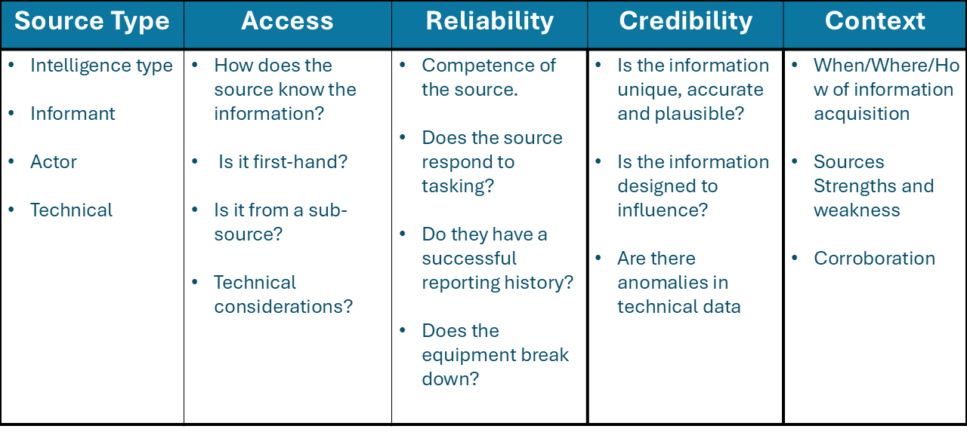
Quality of a Source
Notes:
Graphic: https://public-library.safetyculture.io/products/layup-quality-audit-rt5jljeqgfrplve5
Ok, so the more description the better. So how do you describe an individual source? When we think of the quality of a source, we need to think of a number of different factors:
Source Type –
Informant: Who told us? A military officer? a journalist? A recruited source? Our own defense attaché?
Actor: SIGINT or GEOINT usually. The Minister of defense said… The tank moved from point A to point B
Type: Is it SIGINT or HUMINT? Is there a perception of quality that goes along with type
Access—How did the source know the information?
First hand: Did the source have direct access to the information? Did they witness an action? Maybe by virtue of their employment or living arrangements or personal relationships
Second hand: Did someone tell the source the information? Did they overhear it? Do they run a sub-source network? Did their mom’s hairdresser’s Aunt’s dentist provide the information? I have known of an instance where “God” told the source… now that is a sub-source!
Technical considerations: Is the gadget used to collect the information functioning properly? Is it in an asynchronous orbit? Is there cloud cover? Did it run out of battery?
Reliability – Is the source trustworthy? Does he show up for appointments?
Credibility/Quality –Does the source have a reporting history? Has the information they provided been corroborated?
Context --When and where did the information occur. What are the circumstances related to the information? Do the sources have strengths and weaknesses?
NIFC Tradecraft Handbook 2024
https://inteldocs.intelink.gov/files/details/7389C13F-6869-4B31-B309-C46CDF259309
https://inteldocs.intelink.gov/files/details/7A1127CF-6EFA-426F-8AA8-91375CEFEE8B
Inteldocs | IC Analytic Tradecraft Standard 1 DIA Tradecraft Note 2-17 Sourcing.pdf (intelink.gov)
https://www.dni.gov/index.php/what-we-do/ic-related-menus/ic-related-links/intelligence-community-directives

Slide 11
Source Type | Access | Reliability | Credibility | Context
Intelligence type Informant Actor Technical | How does the source know the information? Is it first-hand? Is it from a sub-source? Technical considerations? | Competence of the source. Does the source respond to tasking? Do they have a successful reporting history? Does the equipment break down? | Is the information unique, accurate and plausible? Is the information designed to influence? Are there anomalies in technical data | When/Where/How of information acquisition Sources Strengths and weakness Corroboration

Slide 12
Quality of Information Check
A Structured Tool to Evaluate Sources
Report Number | Date of Information | Type of Intelligence | Source Description | Relevant Information | Reliability | Credibility | Corroboration | Comments
ABC123 | 26/08/2025 | HUMINT | Retired professional football player. Freelance talent scout for UK Premiere League. Has a history of providing team with accurate information on the capabilities of individual players on Premiere and European league teams | Germany generally favors a high-pressing possession-based system with fullbacks pushing forward aggressively They often try to overload the midfield to control game tempo | The source provides information in a timely manner and responds to specific requests from the coaching staff. | The source is highly qualified to make observations and assessments about the German national team. He has worked with the England national team several times in the past and understands the teams style of play. | Source Report Number XYZ987, a video highlight real of Germany's last five matches corroborates the sources description of Germany's high pressing possession-based system. | Re-posturing our midfield approach would probably disrupt Germany's fullback push.

Slide 14
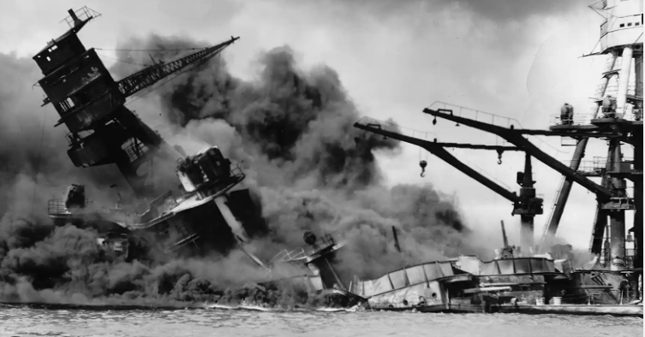
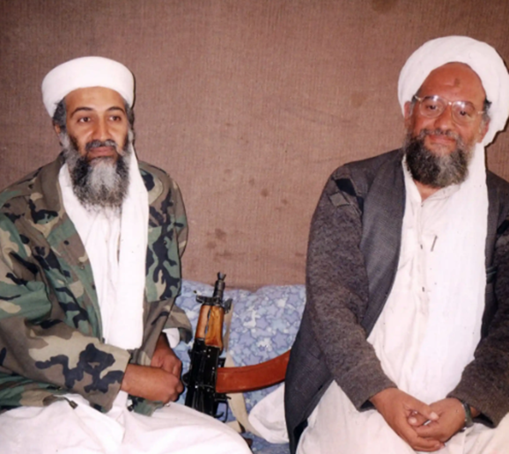
Why is Uncertainty Important
Strategic Surprise
  9/11
  Pearl Harbor
Failure to explain the uncertainty in our judgments can lead to ill-informed decisions and actions. Conversely, providing clients with an appreciation of the uncertainty in our judgments and the analytic process behind them allows them to prepare for potential contingencies and mitigate risk.
Notes:
Army and Navy intelligence warnings to alert Hawaii had different levels of certainty, things were ambiguous and contradictory. For 9/11, there was uncertainty around the intent and level of capability of al-qaida that did not get adequately conveyed to policy makers
Sources:
(U) DIA Tradecraft Note 04-18 Uncertainty (https://inteldocs.intelink.gov/files/details/AEF370D4-6C5C-43B8-A4E9-2D87206A1850)
https://www.9-11commission.gov/report/911Report.pdf
Images:
https://www.britannica.com/event/Pearl-Harbor-attack
https://www.newyorker.com/magazine/2002/09/16/the-man-behind-bin-laden
https://www.cia.gov/readingroom/docs/DOC_0006122443.pdf Pg 38
https://www.nsa.gov/portals/75/documents/about/cryptologic-heritage/historical-figures-publications/publications/wwii/pearl_harbor_revisited.pdf pg 46-50
NSA: intelligence gaps left by unencrypted messages from Japanese army and navy lead to a question of confidence in when and where the Japanese attack was coming

Slide 15
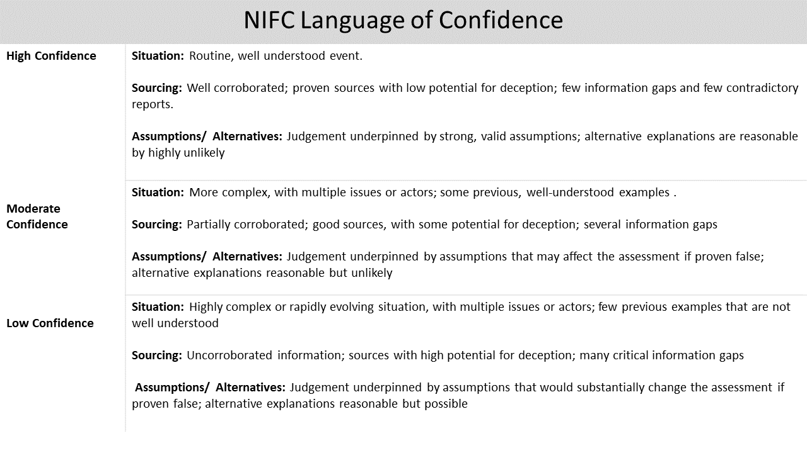
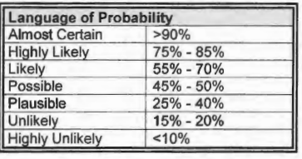
Two Aspects of Uncertainty (NIFC)
Likelihood
Confidence
Assess the chance of a future event or action or to describe or explain a past event or outcome for which some uncertainty remains.
Uncertainty in the analytic process used to reach the assessment. Consider:
Consider:
  Evidence (sources)
  Context
  Trends
  Drivers
  Background
  Historical Precedent
Notes:
From the standard, we want to focus on the two aspects of uncertainty, likelihood and confidence. These two ideas are different.
Likelihood is the probability the event or development you are examining will occur. Confidence is the trust you have in the analytic process you used to reach your main judgment.
Sources:
https://www.odni.gov/files/documents/ICD/ICD-203_TA_Analytic_Standards_21_Dec_2022.pdf
(U) DIA Tradecraft Note 04-18 Uncertainty (https://inteldocs.intelink.gov/files/details/AEF370D4-6C5C-43B8-A4E9-2D87206A1850)

Slide 16
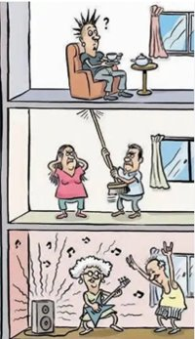
Assumptions, Alternatives, and Gaps
Components of a logical argument that factor into your level of uncertainty.
Assumptions: A statement that is believed to be true but cannot be directly supported with evidence. If your assumption proves wrong, it could affect your assessment on the likelihood if/when an intelligence event will occur.
Alternatives: a plausible alternative answer to your intelligence question. If you create multiple hypotheses to answer a question, one is your main assessment. One of the others is probably your alternative.
Gaps: Information or evidence can be collected to fill the gap given time and resources. Until then, the gap is filled by supposition or assumption.

Slide 17
When to Use Likelihood and Confidence ?
Likelihood- Use these terms to describe the probability of the intelligence development you are assessing.
Confidence – Describes your ability to use the available sources to create a logical argument.
Consider:
Source Quality | Intelligence Gaps | Assumptions | Alternatives
Example: I have high confidence in my assessment that Germany will dominate play if it can use its midfielders to push forward because the assessment is based on highly credible and corroborated expert sources and technical observations of Germany’s game play (source quality). While Germany may change its game play before the match, it is unlikely because it the team has not changed its pattern of play in the last three seasons. (Alternatives)
Example: Germany will almost certainly dominate play when their midfielders push forward. This high-pressing possession-based system will challenge England’s current midfield defense posture.

