Slide 1

Warning

Slide 2
What is Warning?
A distinct communication to a decision maker about threats against a country, or allied security, military, political, information, or economic interests. The message should be given in sufficient time to provide the decision maker opportunities to avoid or mitigate the impact of the threat.
Future based
Probabilities and possibilities-based
Analysis of Alternatives
Vulnerabilities and Opportunities

Slide 3
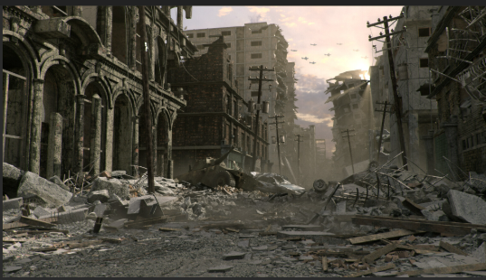
Threats to Warn About
An attack on NATO member or conflict that could require the employment of NATO allied forces and capabilities
Political or economic instability or failed or failing states whose collapse or failure could trigger employment of NATO forces and capabilities
Terrorist, political, economic, military, technological, energy, environmental, societal or other developments that could influence the development and implementation of NATO defense policy, operational or contingency plans and force capabilities

Slide 4
Emerging Warning
Enduring Warning
Range of threats from potential to well characterized
May not be well understood at first and uncertainty is usually high
Collection on emerging concerns may be austere or of questionable quality
Can become enduring warning problems or they can be dismissed
Well known and clearly defined
Recognized and established as high priority threats that NATO forces need to respond to should the situation warrant
Intelligence resources dedicated to enduring problems are more substantial and often better quality
Monitored on a regular basis using an indicator-based methodology

Slide 5
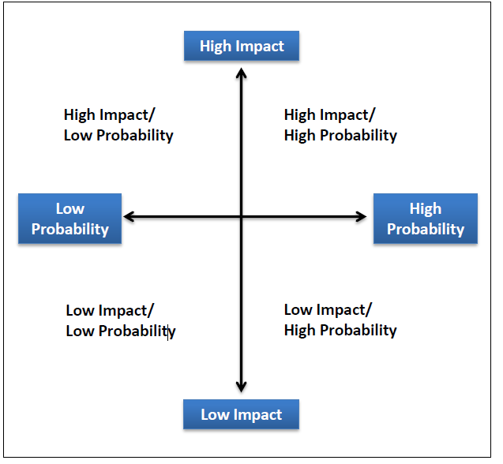
Threat Probability and Impact Spectrum
Which quadrants should we be worried about?
High Impact/High Probability
Requires constant monitoring
High level of collection and analysis
High Impact/Low Probability
Monitored regularly for changes in probability and nature
Greatest danger for surprise

Slide 6
Type of Warning and Timeframe
Strategic | Months to years
Operational | Weeks to months
Tactical | Days to weeks
Do these types and timeframes influence how you warn?

Slide 7
How do these factors influence how you warn?
Enduring V. Emerging
High Impact/High Probability
V.
High Impact/Low Probability
Timeframe

Slide 8

Who are you warning?
Decision making role
Background
How they process information
Biases
Interests

Slide 9


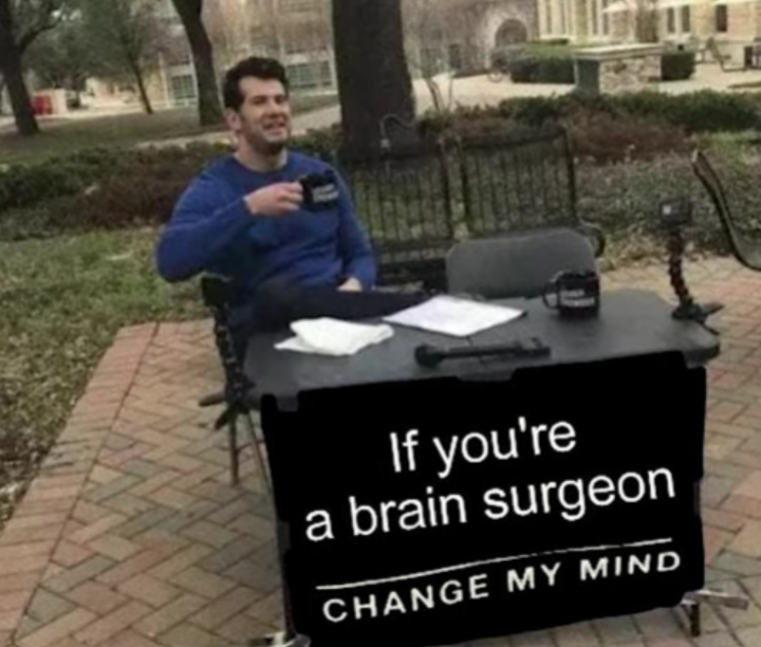
Why Do Use Signposts and Indicators?
Signposts and Indicators provide an objective baseline for tracking events and help achieve the following:
  Detect and monitor changes over time.
  Evaluate competing hypotheses or scenarios.
  Identify and drive collection opportunities.
  Consider various paths a situation could follow.
  Substantiate emerging viewpoints
  Overcomes expertise bias.
  Helps decision makers track future developments Builds a more concrete case for the analytic conclusions
Notes:
The human mind sometimes sees what it expects to see and can overlook the
unexpected. Identification of indicators creates an awareness that prepares the mind
to recognize early signs of significant change. Change often happens so gradually
that analysts do not see it, or they rationalize it as not being of fundamental
importance until it is too obvious to ignore. Once analysts take a position on an
issue, they can be reluctant to change their minds in response to new evidence.

