Slide 1



NATO STEADFAST INTEREST 25-2
Analytic Tradecraft Instruction
3-5 September 2025
Notes:
Picture CIA.gov

Slide 2

Learning Goals
Students will be able to incorporate basic analytic tradecraft into a warning product
Students will be able to apply several structured analytic techniques to a warning problem that will add rigor to their analysis.
Students will be able to structure a logical argument and compose a basic warning product.
What is your goal for our days together?
Notes:
Generated from exercise requirements. Graphics from PowerPoint (UNCLASS)

Slide 3
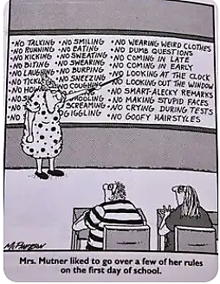
Class Expectations
Individual and Group Exercises:
    Fully Participate in exercises. They will prepare you for assignments.
Assignments:
    Short Warning Intelligence Summary that includes your main analytic judgment for the STEADFAST INTEREST scenario
    Five to Seven Minute Briefing on the indicators of your main assessment for STEADFAST INTEREST J2
Parking Lot:
    Interesting, but tangential Ideas
    Questions
Notes:
Comic: twitpic.com

Slide 4

Class Rules
Be Respectful
Participate
No Rank
No Dumb Questions
Vegas Rules
Mind the time

Slide 5
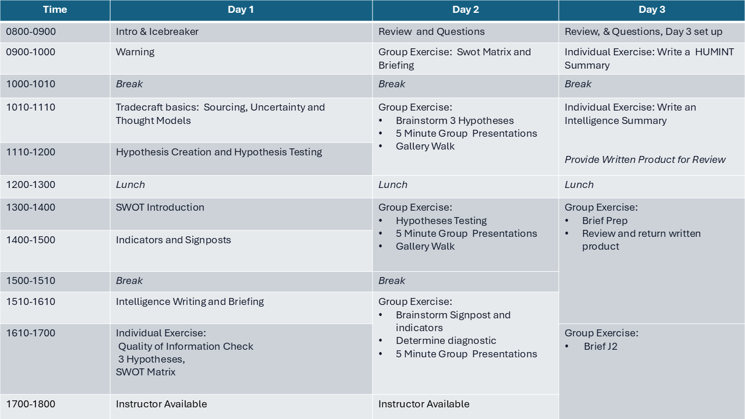
Notes:
Generated from class content and exercise timetable (UNCLASS)

Slide 6

A Football Example
Football is universal…
Germany V. England
…except for Americans
You are going to have to help fill in details.
Simulates country V. Country of exercise scenario
Simple and short.

Slide 7

Getting to Know You
  Name
  Country
  Organization
  Experience
  What is the oddest job you ever had?
Notes:
https://mnmmath.wordpress.com/2016/08/23/melting-ice-on-day-three/

Slide 8
Time | Day 1 | Day 2 | Day 3
0800-0900 | Intro & Icebreaker | Review and Questions | Review, & Questions, Day 3 set up
0900-1000 | Warning | Group Exercise: Swot Matrix and Briefing | Individual Exercise: Write a HUMINT Summary
1000-1010 | Break | Break | Break
1010-1110 | Tradecraft basics: Sourcing, Uncertainty and Thought Models | Group Exercise: Brainstorm 3 Hypotheses 5 Minute Group Presentations Gallery Walk | Individual Exercise: Write an Intelligence Summary Provide Written Product for Review
1110-1200 | Hypothesis Creation and Hypothesis Testing
1200-1300 | Lunch | Lunch | Lunch
1300-1400 | SWOT Introduction | Group Exercise: Hypotheses Testing 5 Minute Group Presentations Gallery Walk | Group Exercise: Brief Prep Review and return written product
1400-1500 | Indicators and Signposts
1500-1510 | Break | Break
1510-1610 | Intelligence Writing and Briefing | Group Exercise: Brainstorm Signpost and indicators Determine diagnostic 5 Minute Group Presentations
1610-1700 | Individual Exercise: Quality of Information Check 3 Hypotheses, SWOT Matrix |  | Group Exercise: Brief J2
1700-1800 | Instructor Available | Instructor Available

